Slide 1

Improving Length of Stay Prediction
Using a Hidden Markov Model
S04
Machine Learning in Clinical Predictive Modeling I
Presenter : Mani Sotoodeh
Institution : Department of Computer Science - Emory University
Twitter: @Manis29467226
#IS19
Source

Slide 2

Importance of Length of Stay Prediction
Intervention to prevent adverse outcomes
Optimization of resource allocation and staff
Improving patients' satisfaction and hospitals’ reputation
Source
Class | < 48 Hours | 2-5 days | > 5 days
Accuracy | 53.1 % | 59.8 % | 31.1 %
Nassar Jr AP, Caruso P. ICU physicians are unable to accurately predict length of stay at admission: a prospective study. International Journal for Quality in Health Care. 2015;28(1):99–103.
Notes:
First talk about the task being difficult and Physician correctly predict short or long staying patients only 50% of time
(Equipment and Beds)
Allocation of staff and care to high risk patients

Slide 3
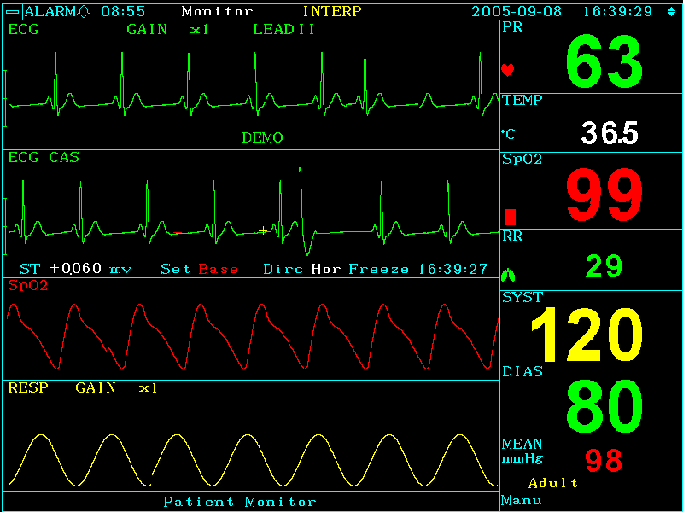
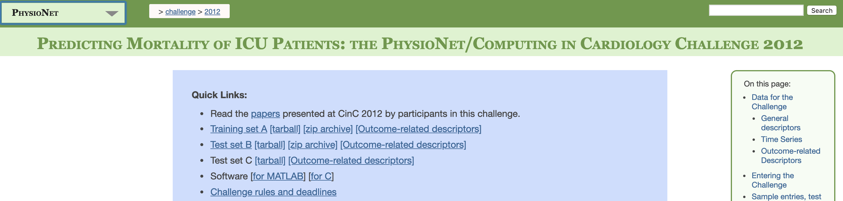
Dataset : Physionet2012 Challenge
Public, Reproducible
4000 patients
37 physiological measurements
48 hours after ICU admission
Source
Link to dataset
Notes:
Higher availability for comparison
, i.e. a single hospital
Also some demographics (i.e. age, gender)
Sufficient size for learning, realistic for practical purpose

Slide 4
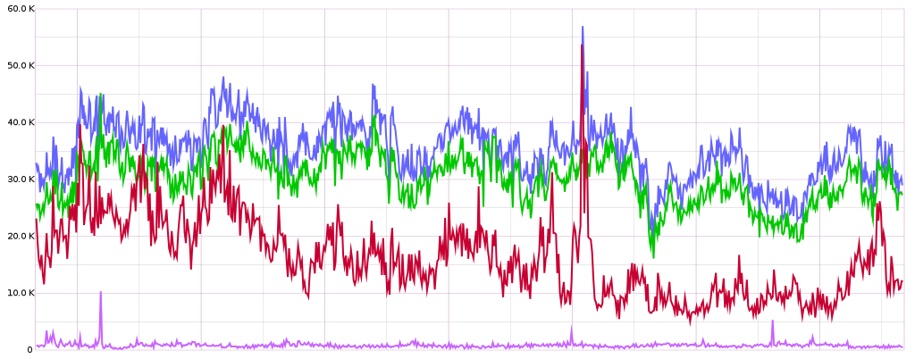
Regression Problem Setup
Selected patient’s time series data for first 48 hours
Feature | Missing % | Avg update frequency (hours)
Heart Rate | 1.6 | 1.05
Temperature | 1.6 | 3.7
Glasgow Coma Scale | 1.6 | 17.33
White Blood Cell Count | 1.8 | 17.057
Serum Glucose | 2.8 | 4.03
Urine Output | 2.9 | 1.89
NIDiasABP | 12.7 | 1.87
Source
12
24
36
48
Time(hours)
Prediction Model
Patient’s Length of Stay(days)
Notes:
Regression → more precise
Lasso,ridge, negative binomial, poisson and Support vector machine Regressions
Impute results in bias, where more data is available through data, better signal for patient states, good proxies
Input : Physiological Measurements throughout time for 48 hours
Output : Length of stay in ICU in days

Slide 5
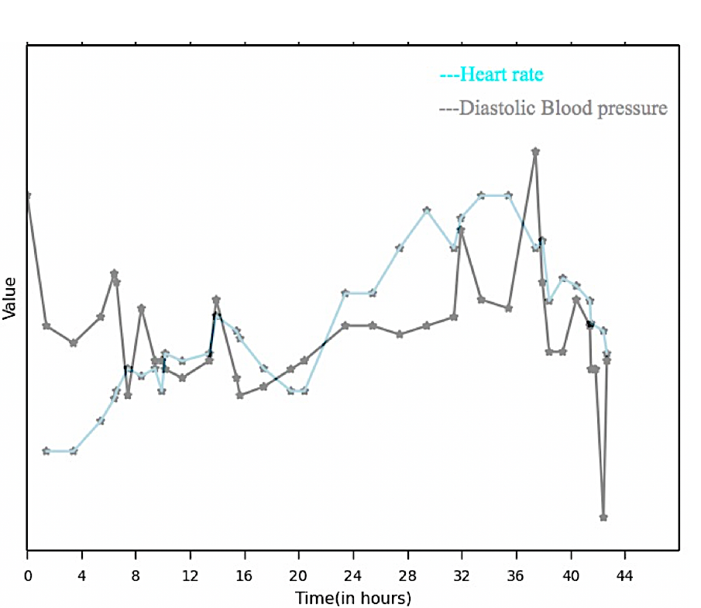
Baseline Models (5 regression models)
Flattened Features :
Annotated example for a given patient and 2 physiological measurement
Heart Rate
Minimum
Blood Pressure
Maximum
BP Maximum
BP Earliest
HR Maximum
Average
Value
HR Average
Earliest
HR Last
BP Last
BP Average
Last
HR Minimum
HR Earliest
BP Minimum
Time (in hours)
Notes:
Utilization of more temporal information in HMM
Meanwhile HMM Model attempts to utilize all temporal information by considering all values
Less parameters to learn, less complexity, explainability transiton and pie and emission probabilities
Five common regression models: LASSO regression
Ridge regression
Poisson regression
Binomial regression
Support vector regression (SVR)
(5 statistics) for each of the 7 variables
35 features in total for each patient

Slide 6
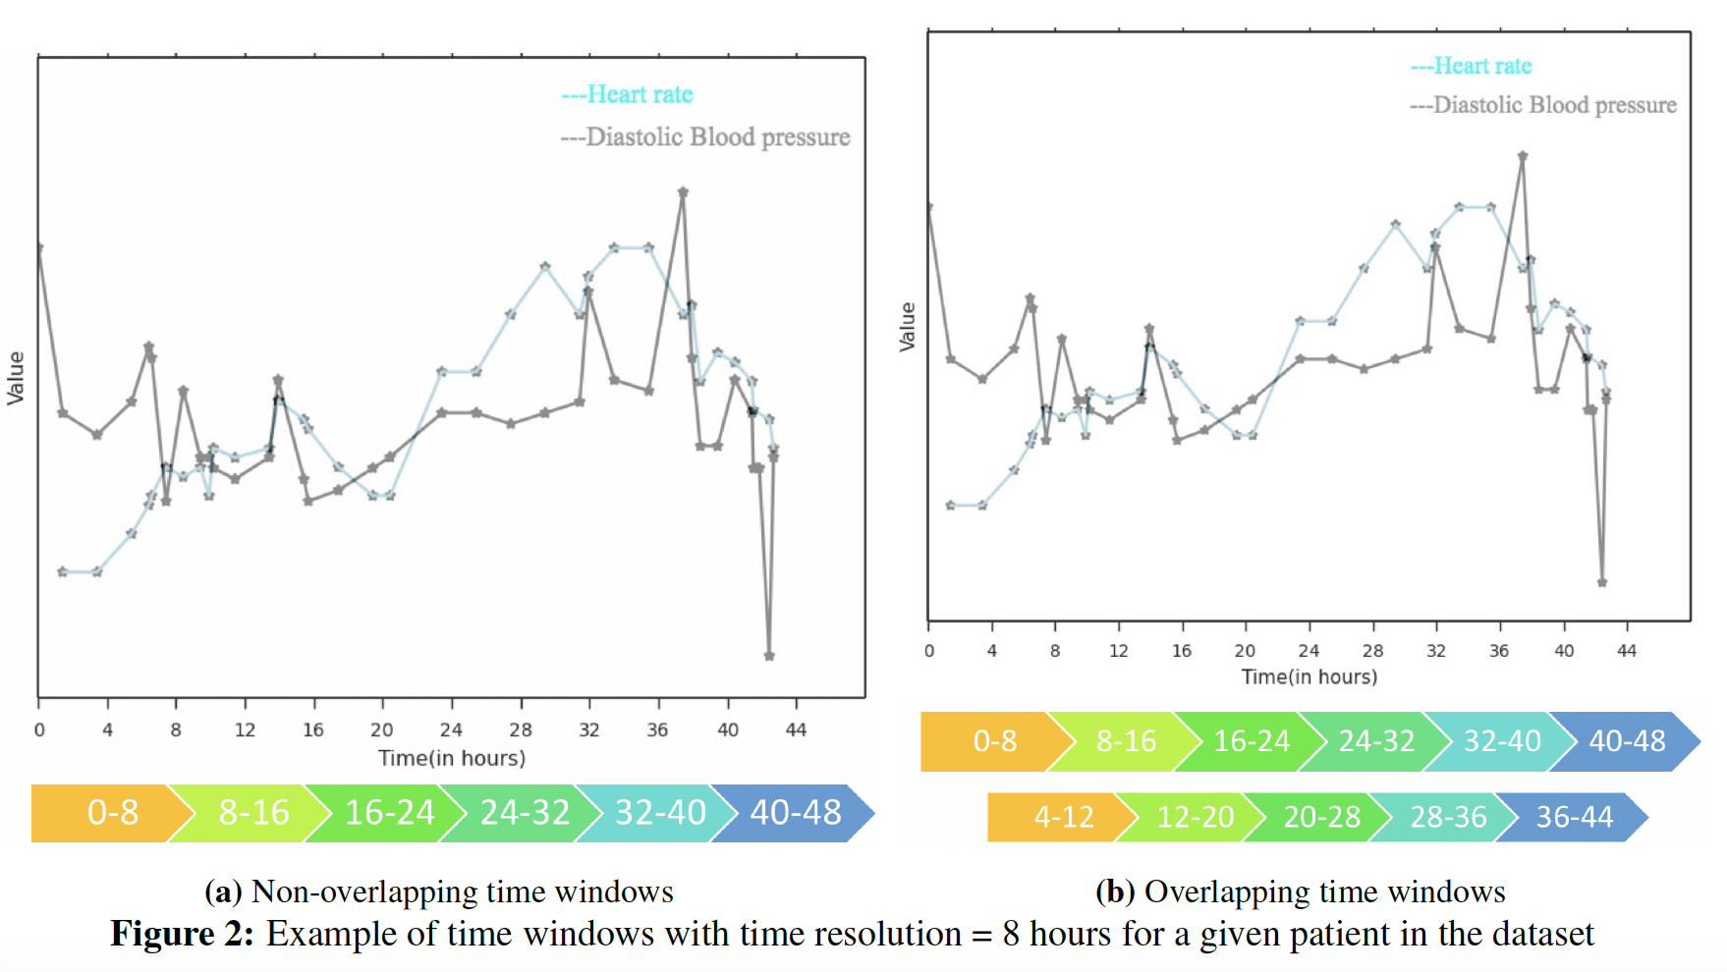
Motivation for our model
Dynamics of Physiological Signals
Interpretability
Heart Rate
Blood Pressure
Value
overlooked
Hidden states
Robust Learning
Observations
Time (in hours)
Notes:
Paramtetr interpretablility
Providing more data to model
Capturing more dynamics
Reds capturing both local minimum points in the same interval while they have significant difference in time, five critical points in the same interval
The puruple ones can better capture what happened before and after these points, capturing more trends, dividing critical points throughout intervals
Transitions

Slide 7
HMM Model Big Picture
Parameters: # of states = 5 Time resolution = 8 # of sequence = 6
Physiological Measures
Aggregating temporally
Observations for a multi-feature Gaussian model
t HR BP Glucose .... Temp
0.5 98 9 80 37
2.1 60 8 95. 32
. . . . .... 40
48 75 7 78. 43
HR BP ... Temp
Window1 82.4 8.4 ... 35.4
Window2 88.3 7.9 ... 38.6
. . . ... .
window6 105.7 6.5 ... 39.5
HMM Model
5 5 4 2 3 3
First state probs:
[ 0.1 0.2 0 0 0.7
Last state probs:
0 0.1 0.8 0.1 0]
Average, median or last time point value
First and last worked best
Lasso Regression Model
Sequence of States
LOS is 5 days
A row of feature matrix
Notes:
Len(Sequence) = # time windows
Spits out likelihood of each state for a given time window

Slide 8
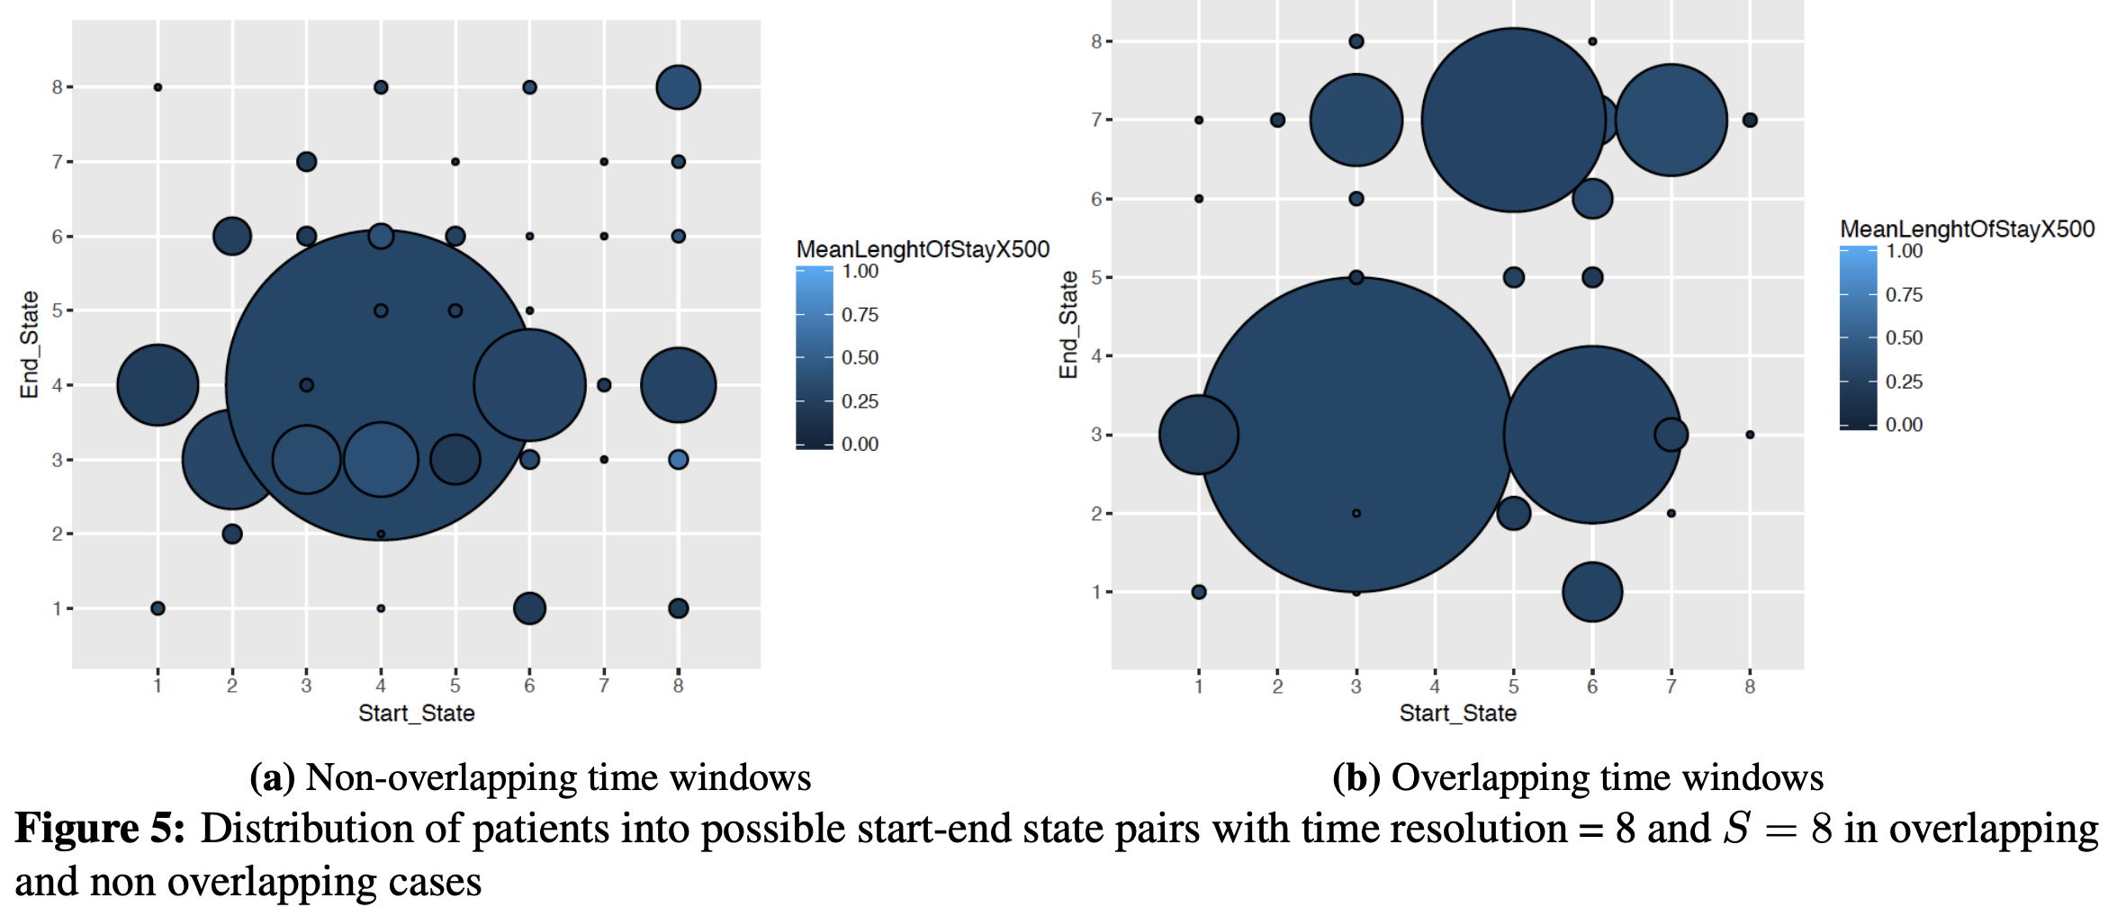
Non/Overlapping time windows
Non overlapping time windows
Overlapping time windows*
Distribution and length of stay of patients across different start end pairs
Crowded pair(4 vs 6)
Single patient pairs (28 vs 14)
Notes:
Well distributed
We also considered certainty for that look in the paper

Slide 9
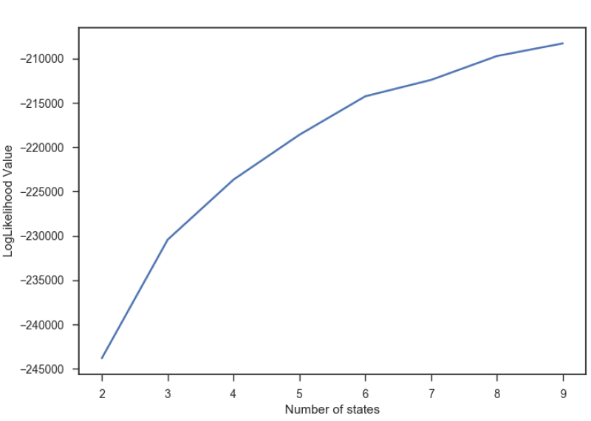
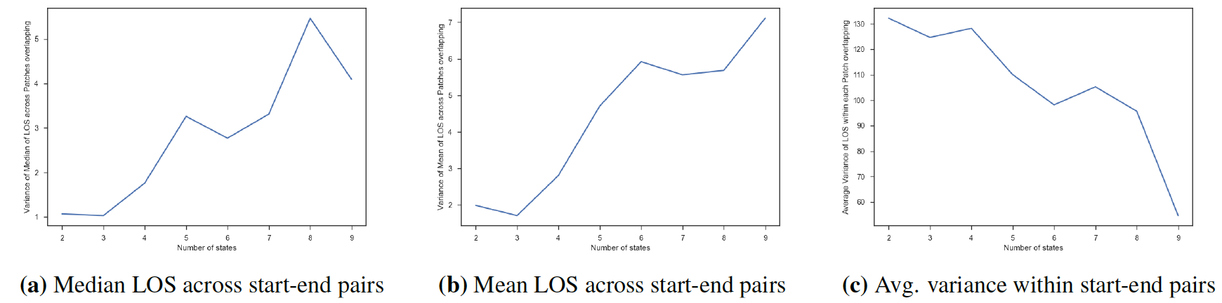
Optimum number of states
Number of states = 8
Number of states = 8
Number of states = 8
Number of states
Number of states
Likelihood Value
Variance of Median LOS
Number of states
Average variance of LOS
Notes:
first is homogeneity
Second is distinguishability
lower is better
Homogeneity of Patients belonging to one start-end pair

Slide 10
RMSE Comparison
Model Description | RMSE ( In hours)
Ridge Regression (7 flattened features) | 236.91
Poisson Regression (7 flattened features) | 235.26
Negative Binomial Regression (7 flattened features) | 235.01
RBF SVR (7 flattened features) | 236.97
Lasso Regression* (7 flattened features) | 234.19
HMM Method** ( 7 features) | 228.12
SAPS-II (14 features) | 225.05
Notes:
Saps II has 14 features, 7 additional features
Tried including all, seemed rather like modelling noise square was one, capturing time evolution,not a fair baseline , correlation discovery single hmm might not be the best choice, different rates of update, how to tie different states together
Compare lasso and HMM

Slide 11
Combining ICU Types
ICU Type | RMSE mean of difference w.r.t baseline
1 Coronary Care | -1.97
2 Cardiac Surgery | -9.39
3 Medical | -7.56
4 Surgical | -6.07
ALL | 6.58
Combined (1,2) (3,4) | (-9.48)(-9.96)
Combined (1,2,3) (4) | (-12.44) (-4.66)
Combined (1,2,4) (3) | (-1.7) (-7.45)
Notes:
Intuitively it makes sense to combine 1 and 2 and 3 and 4 for better performance and solve sparsity
Best baseline lasso ran a t test Ran a 100 runs , average RMSE of a given patient

Slide 12
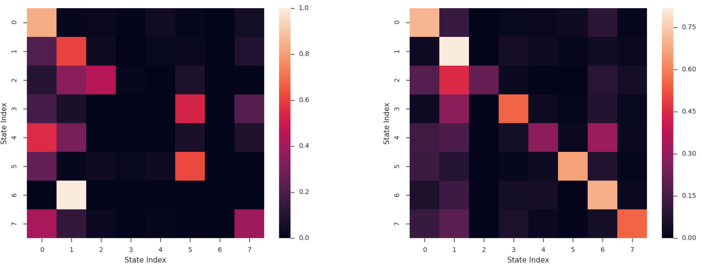
Interpretability
Next State
Next State
Most probable starting state
Trap state
Current state
S/ E |  | Not
7 | 6.43 | 4.85
6 | 9.6 | 6.07
Current state
Transition matrix ICU types 1 & 2
Transition matrix ICU types 3 & 4
Notes:
Between different states interpret
46000

Slide 13

Conclusion, Future Work
Lower RMSE, Better interpretability
Generalizability, Replication on MIMIC III dataset
More flexibility in #states for different populations
Auxiliary information for segmenting patients
Constraints in learning HMM parameters
Minimum probability in Transition matrix
Source
Notes:
7 feats vs 2000 not have assessd losing some predictability in the expense of explainability
Limitations,
: Lower number of samples
Replicating the same procedure on MIMIC II dataset
Enforcing Variability
(e.g., demographics, socioeconomic status)
Minimum probability in Transition matrix
Sufficient size for learning, realistic for practical purpose

Slide 14
Thank you!
Questions?
Email: msotood@emory.edu
Notes:
Benchmarking deep learning models on large healthcare datasets
Journal of Biomedical Informatics
Tried incorporating more features

Slide 15
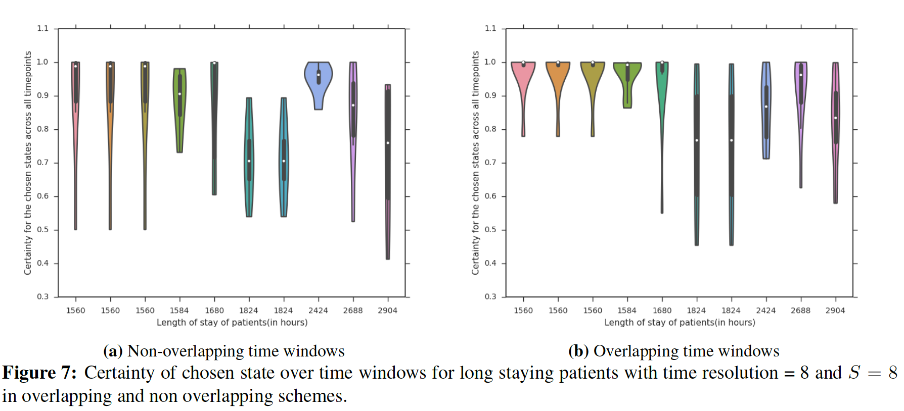
Design choices-Non/Overlapping time windows-continued

Slide 16
Motivation, The case for HMM
Regression → more precise
Dynamics of physiological signals
States interpretability
Notes:
Rather than classification
Possibly indicating severity or progress of patients’ underlying disease symptoms
Evolution through time

Slide 17
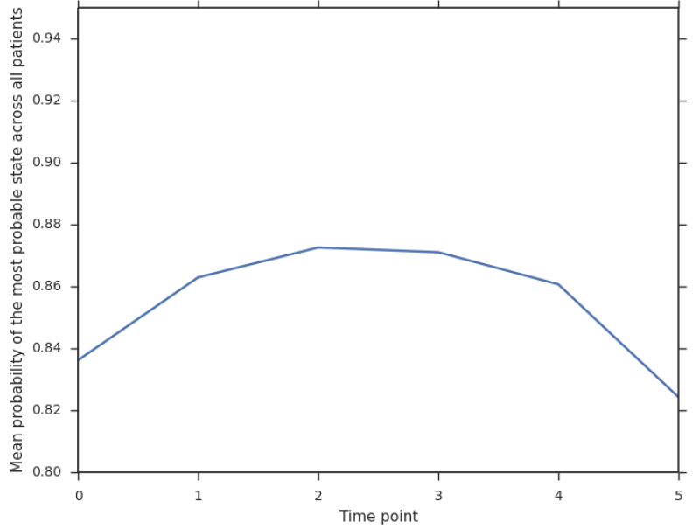
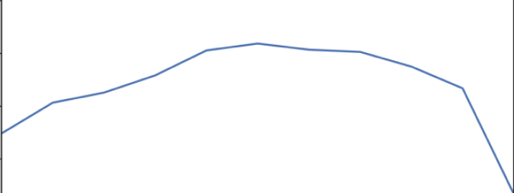
Design choices-Non/Overlapping time windows- continued
On mimic Mine : 159 / 24 = 6.62
Them using all features 136 features
8
Non overlapping time windows
Certainty of inferred state at each time window, averaged for all patients
Overlapping time windows
Time frame index

Slide 18
Certainty
1. Comparing Hidden Markov Models and Long
Short Term Memory Neural Networks for
Learning Action Representations
Maximilian Panzner and Philipp Cimiano
Semantic Computing Group, CITEC, Bielefeld University,
mpanzner@cit-ec.uni-bielefeld.de
2. Benchmarking deep learning models on large healthcare datasets
Sanjay Purushothama,1, Chuizheng Mengb,1, Zhengping Chea, Yan Liua,⁎
3. Journal of biomedical informatics
Techniques for Interpretable Machine Learning
Mengnan Du, Ninghao Liu, Xia Hu
Overlapping time windows
Non overlapping time windows
Time frame index
Certainty across time windows
Notes:
ICU specific low number of patients
ICU type dynamics, much less data but comparable accuracy

